Slide 1






Trading social status for genetics in marriage markets: Evidence from UK Biobank
Abdel Abdellaoui Amsterdam UMC Oana Borcan University of East Anglia Pierre Chiappori Columbia David Hugh-Jones University of East Anglia
Leuven Nature & Nurture Workshop 2022

Slide 2
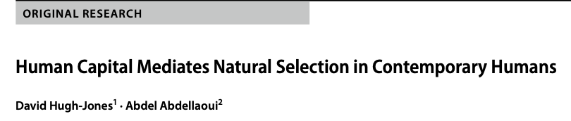
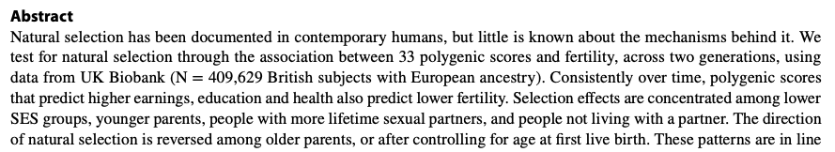
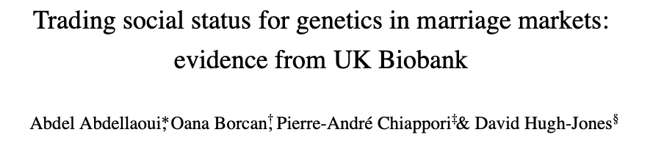
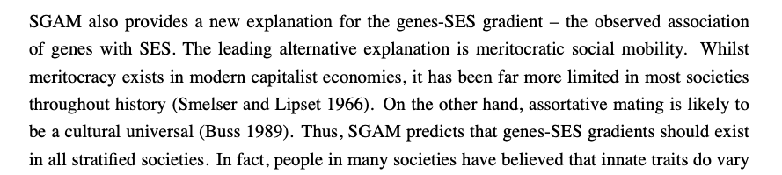
Advert: seeking collaborators
When did this start being true?
Can we test this?

Slide 3
Goals of this paper
In increasing order of ambition:
Explain a puzzle about the intergenerational persistence of inequality.
Persistence measured over the long run is much higher than we would expect from parent-child dyad data.
Provide a new explanation of the genes-SES (socio-economic status) gradient.
Rethink the nature of inequality in historical human societies.
Change how we think about genetic variation.

Slide 4
Many genetic measures, including polygenic scores for education and health outcomes, differ between low and high Socio-Economic Status (SES) people.
The leading explanation for this genes-SES gradient is meritocracy: genetic variants that cause success in labour markets lead to upward mobility.
An alternative explanation: both some genetic variants, and high SES, are desirable qualities in marriage markets.
If you are rich or privileged, you may marry someone intelligent or good-looking.
Both SES and genetics are then inherited by the next generation.
Under Social-Genetic Assortative Mating:
Shocks to SES are reflected in the DNA of subsequent generations.
The genes-SES gradient depends on social structure, e.g. on persistence of inherited wealth.
The genes-SES gradient is likely historically widespread, beyond modern meritocracies.

Slide 5
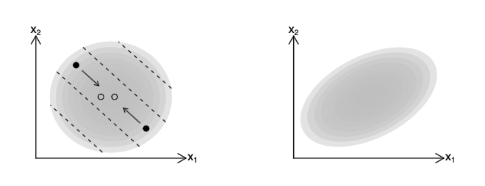
Intuition
SES
SES
GENES
GENES
Parents
Children
Parents (●) mate along iso-attractiveness curves (- - - - -).
Their children (○) are between them in expectation.
As a result, the children’s distribution is squashed along the attractiveness gradient.

Slide 6
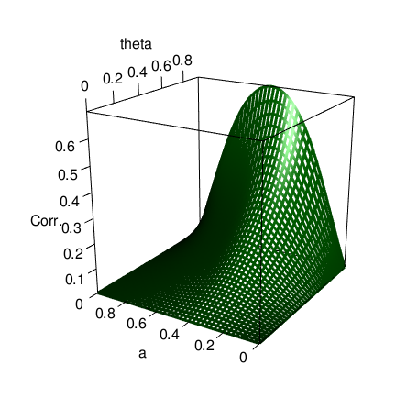
In our model, the correlation between genes and SES (Corr.) depends on
the relative importance of genes compared to SES in marriage markets (a);
intergenerational persistence of SES (theta).

Slide 7
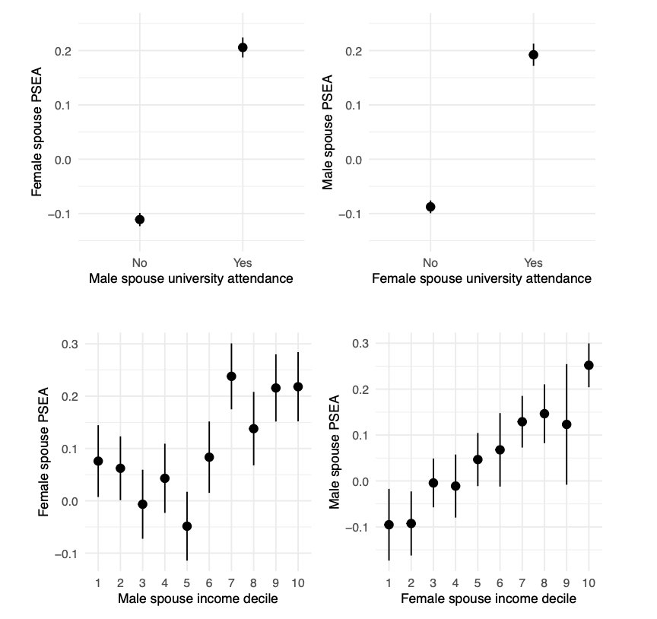
35,682 UK Biobank spouse pairs

Slide 8
These results could just be due to genetic assortative mating (GAM).
We need a “shock” to SES which is not correlated with genetics.
We use birth order.
Siblings have the same expected polygenic scores, by the “lottery of meiosis”.
Early-born siblings receive more parental care and have better life outcomes, including SES.

Slide 9







Estimation strategy
Birth order
Spouse
PSEA
SES
Mediators
Mediators
Other

Slide 10
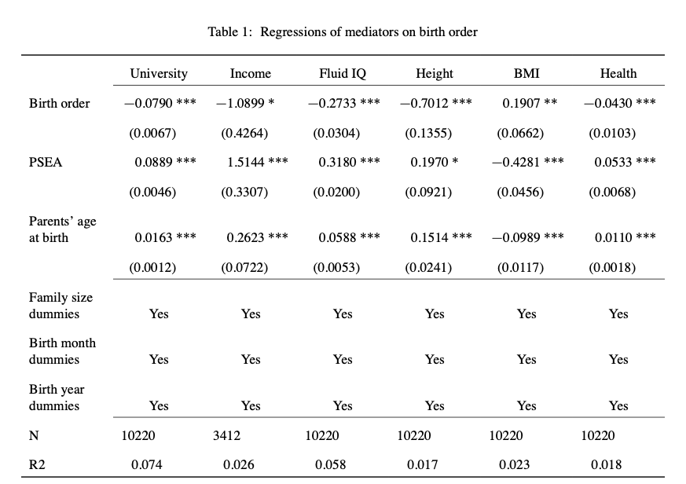


BO
SES

Slide 11
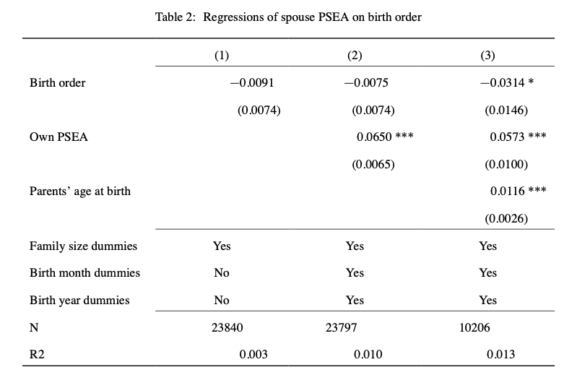


BO
PSEA

Slide 12
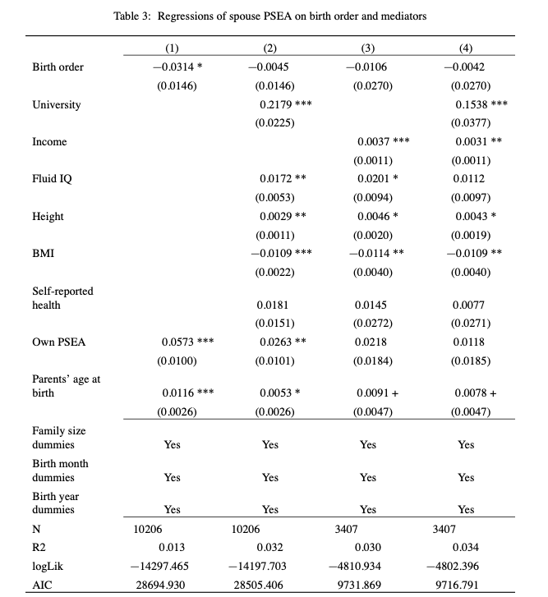
SES mediators
Non-SES mediators
BO
PSEA
SES

Slide 13
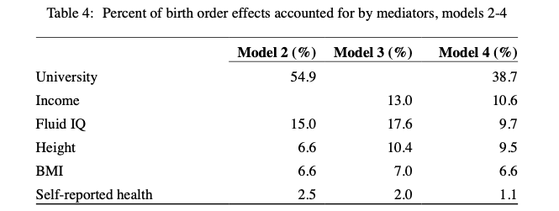

BO
PSEA
SES
Robustness

Slide 14
Socio-Genetic Assortative Mating
Explain a puzzle about the intergenerational persistence of inequality.
Inequality can persist because of unmeasured genetic variation (Clark 2021). Genetics can be a mediator, not just a confound, for transmission of SES over generations.
Provide a new explanation of the genes-SES gradient.
In modern meritocracies, genes affect SES.
Under SGAM, in all societies, SES can affect genes.
Shocks to SES are reflected in the DNA of subsequent generations.
Rethink the nature of inequality in historical human societies.
Prediction: a genes-status gradient should be visible in ancient DNA.
SGAM plus differential reproduction could induce differences in e.g. appearance between groups.
Change how we think about genetic variation.
Yes, genes are “biological”…
But across generations, genetic variation is a social outcome.
The size of the genes-SES gradient is affected by socio-economic institutions.
Collaborations?

Slide 15

Thank you!
Genetics
Society
“Part of the beauty of me is that I am very rich.”

Slide 16
Spouse pairs
Some respondents in the Biobank sample have a genetic child who is also in the sample.
Among our spouse pairs, 511 have a genetic child of at least one partner in the sample.
For 86% (441) of these, the child is the genetic child of both partners.
Comparison: 11% of families with dependent children included a stepchild in England and Wales in 2011 (National Statistics 2014).

Slide 17
Robustness
Extra mediators: BMI, self-reported health.
Birth order is independent of 33 different polygenic scores.
Results are qualitatively robust…
… if we use birth order dummies: strongest effect for first child versus subsequent children.
… using age left full-time education as the key mediator
… for males and females only (initial birth order coefficient is not significant)
… for couples with children

Slide 18
Bibliography
Halsey, AH. 1958. “Genetics, Social Structure and Intelligence.” British Journal of Sociology 9 (1): 15–28.
Hugh-Jones, David, Karin JH Verweij, Beate St Pourcain, and Abdel Abdellaoui. 2016. “Assortative Mating on Educational Attainment Leads to Genetic Spousal Resemblance for Polygenic Scores.” Intelligence 59: 103–8.
Hugh-Jones, David and Abdel Abdellaoui. 2022. “Human capital mediates natural selection in contemporary humans “. Working paper.
Lindahl, Lena. 2008. “Do Birth Order and Family Size Matter for Intergenerational Income Mobility? Evidence from Sweden.” Applied Economics 40 (17): 2239–57.
National Statistics. 2014. “Stepfamilies in 2011.” https://webarchive.nationalarchives.gov.uk/20160105222243/http:// www.ons.gov.uk/ons/rel/family-demography/stepfamilies/2011/stepfamilies-rpt.html.
Rimfeld, Kaili, Eva Krapohl, Maciej Trzaskowski, Jonathan R. I. Coleman, Saskia Selzam, Philip S. Dale, Tonu Esko, Andres Metspalu, and Robert Plomin. 2018. “Genetic Influence on Social Outcomes During and After the Soviet Era in Estonia.” Nature Human Behaviour 2 (4): 269–75.
Schwartz, Christine R, and Robert D Mare. 2005. “Trends in Educational Assortative Marriage from 1940 to 2003.” Demography 42 (4): 621–46.
Shakespeare, William. 1595. A Midsummer Night’s Dream.
Solon, Gary. 2018. “What Do We Know so Far about Multigenerational Mobility?” The Economic Journal 128 (612): F340–52.
Tambs, Kristian, Jon Martin Sundet, Per Magnus, and K re Berg. 1989. “Genetic and Environmental Contributions to the Covariance Between Occupational Status, Educational Attainment, and IQ: A Study of Twins.” Behavior Genetics 19 (2): 209–22.
Trzaskowski, Maciej, Nicole Harlaar, Rosalind Arden, Eva Krapohl, Kaili Rimfeld, Andrew McMillan, Philip S. Dale, and Robert Plomin. 2014. “Genetic Influence on Family Socioeconomic Status and Childrens Intelligence.” Intelligence 42 (January): 83–88
Abdellaoui, Abdel, David Hugh-Jones, Löıc Yengo, Kathryn E Kemper, Michel G Nivard, Laura Veul, Yan Holtz, et al. 2019. “Genetic Correlates of Social Stratification in Great Britain.” Nature Human Behaviour 3 (12): 1332–42.
Black, Sandra E, Paul J Devereux, and Kjell G Salvanes. 2011. “Older and Wiser? Birth Order and IQ of Young Men.” CESifo Economic Studies 57 (1): 103–20.
Booth, Alison L, and Hiau Joo Kee. 2009. “Birth Order Matters: The Effect of Family Size and Birth Order on Educational Attainment.” Journal of Population Economics 22 (2): 367–97.
Clark, Gregory. 2021. “For Whom the Bell Curve Tolls: A Lineage of 400,000 English Individuals 1750-2020 Shows Genetics Determines Most Social Outcomes.” Working Paper. http://faculty.econ.ucdavis.edu/faculty/ gclark/ClarkGlasgow2021.pdf.
Clark, Gregory, and Neil Cummins. 2015. “Intergenerational Wealth Mobility in England, 1858–2012: Surnames and Social Mobility.” The Economic Journal 125 (582): 61–85.
Eika, Lasse, Magne Mogstad, and Basit Zafar. 2019. “Educational Assortative Mating and Household Income In- equality.” Journal of Political Economy 127 (6): 2795–835.
Fernandez, Raquel, Nezih Guner, and John Knowles. 2005. “Love and Money: A Theoretical and Empirical Analysis of Household Sorting and Inequality.” Quarterly Journal of Economics 120 (1): 273–344.
Fernández, Raquel, and Richard Rogerson. 2001. “Sorting and Long-Run Inequality.” Quarterly Journal of Economics 116 (4): 1305–41.
Furnham, Adrian. 1993. “Just World Beliefs in Twelve Societies.” Journal of Social Psychology 133 (3): 317–29.
Gramsci, Antonio. 1971. Selections from the Prison Notebooks. Lawrence; Wishart London.
Greenwood, Jeremy, Nezih Guner, Georgi Kocharkov, and Cezar Santos. 2014. “Marry Your Like: Assortative Mating and Income Inequality.” American Economic Review 104 (5): 348–53.

